Slide 1
UNIT 6 Microsoft Windows Basics

Slide 2
Learning Objectives
Participants will understand what the Microsoft Windows operating system is and its basic history
Windows OS Basics
Windows Version History
Windows-Specific Terms and Definitions

Slide 3
UNIT 6 – SECTION 1 Windows Version History

Slide 4
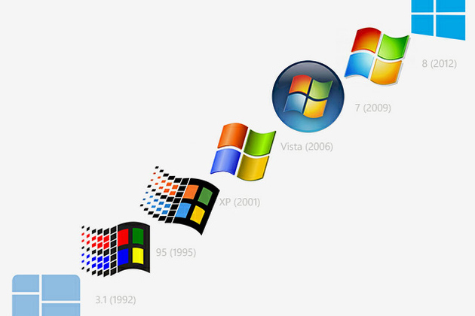
Version History
First version of Windows widely released was MS-DOS in 1981
New workstation and server versions are often released around the same time and are closely related.
Only OSes that have been used in the competition will be covered.
Windows 10 and Server 2016 are not listed, though they were used in the competition.

Slide 5
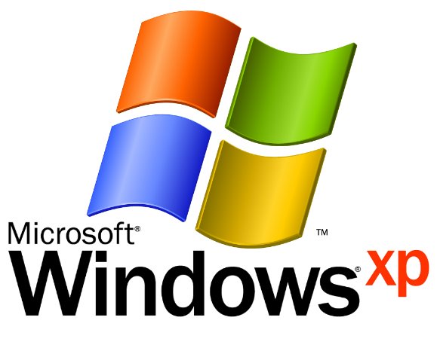
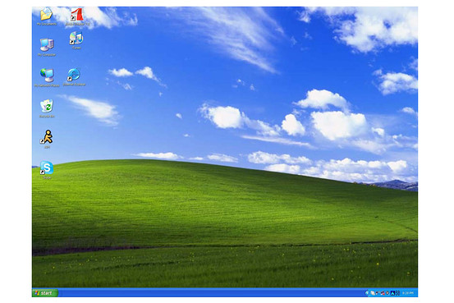
Windows XP and Server 2003
Release Dates: 2001 (XP) and 2003 (Server 2003)
Major Features
Lightweight – Only requires 64 MB of RAM and 1.5 GB of hard drive space
Focus on user eXPerience – sleek graphics, simplicity, and basic features
XP has been updated with three Service Packs and Server 2003 has two
XP is the first version to include Remote Desktop, which allows a user to connect to a system remotely
Notable Security Concerns
In 2014, Microsoft discontinued support and updates for Windows XP and Server 2003, meaning systems running those OSes may now be more vulnerable to attack.
Almost 250 million people still use Windows XP
Many systems running these OSes may also have outdated hardware and applications that also have security concerns.
Source: https://redmondmag.com/articles/2015/04/08/windows-xp-usage.aspx

Slide 6
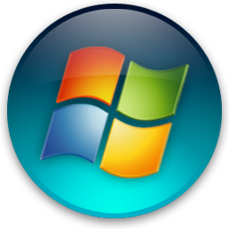
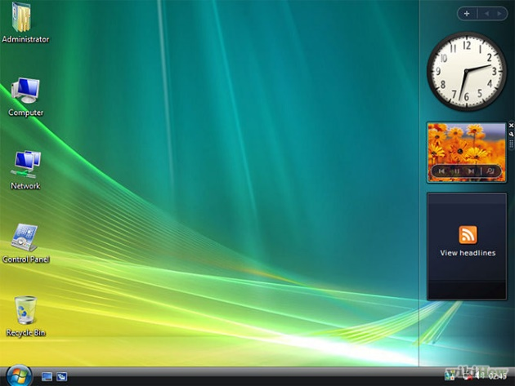
Windows Vista and Server 2008
Release Dates: 2006 (Vista) and 2008 (Server 2008)
Major Features
Updated GUI and a Windows Sidebar where users can place Desktop Gadgets, like weather and time applets
Windows Defender – security tool featuring antispyware capabilities
Backup and Restore Center – allows users to more efficiently back up files and create system images
User Account Control (UAC) – informs user when a program requires administrator-level permission
Bitlocker – Full disk encryption
Vista and Server 2008 each have two Service Packs
Notable Security Concerns
Vista included major architectural changes, making it significantly more secure than base Windows XP.
While UAC is a useful security tool, it caused major usability issues for the average user.

Slide 7
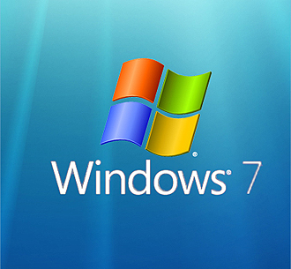
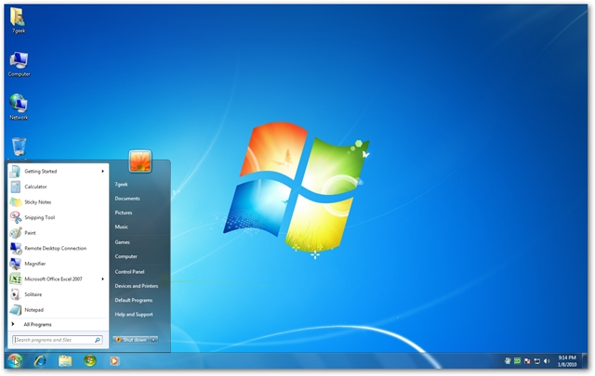
Windows 7 and Server 2008 R2
Release Date: 2009 (Both)
Major Features
Significant speed improvements that Vista lacked due to bloated OS size
Windows 7 and 2008 R2 each have one Service Pack
Improved searching and more nuanced UAC, which provides the ability to slide between different security levels
Action Center – centralized location to notify user of major security issues
Windows now allows for biometric authentication
Notable Security Concerns
Initial launch only had minimal security fixes over Vista.
As the most widely used OS, Windows 7 is the most targeted by malicious users and software.

Slide 8
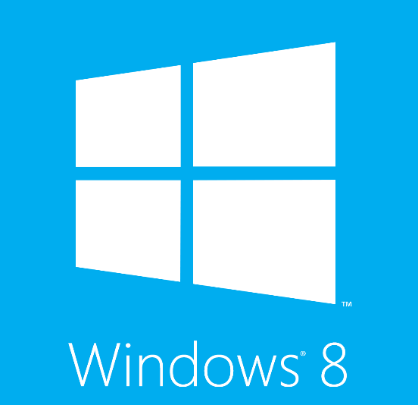
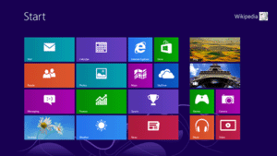
Windows 8 (8.1) and Server 2012
Release Dates: 2012 (Windows 8 and Server 2012) and 2013 (Windows 8.1)
Major Features
Focus on providing an OS for tablets, including touchscreen and gesture capabilities, a tiled Start screen, Windows Store, and “hot corners”
Windows 8.1 returned the Start button that was missing in Windows 8
Windows Defender now includes Microsoft Security Essentials, which provides antivirus support
Cloud Storage and Sync – users can now sync their settings and backup their data to the cloud
Notable Security Concerns
Some applications were rewritten to maintain compatibility with the new GUI, which could lead to new security flaws.
“Picture passwords” can be more easily cracked than traditional passwords.

Slide 9
UNIT 6 – SECTION 2 Windows Basics

Slide 10
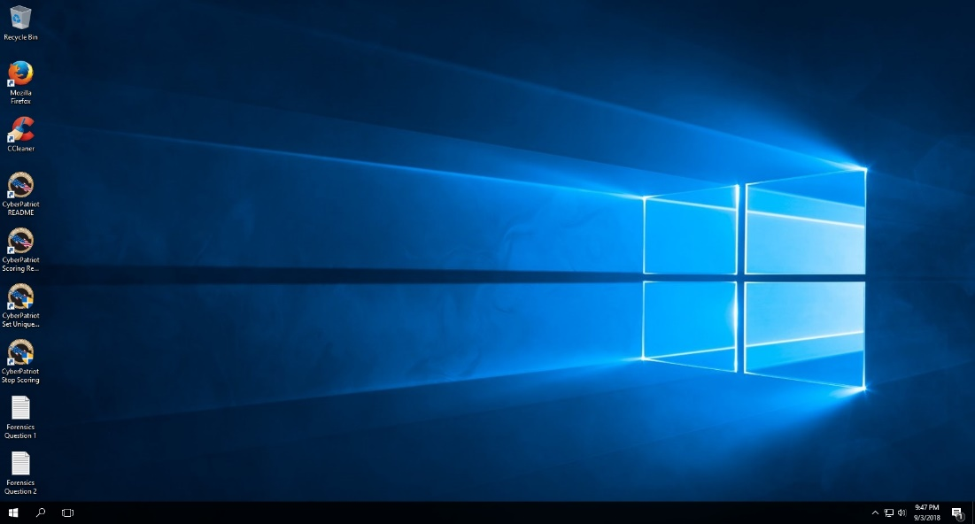
Microsoft Windows: Desktop
This is the main screen area a user sees after logging in on most Windows operating systems.
Recycle Bin: deleted files are sent here before being completely deleted from a computer
Icons/Shortcuts: thumbnail pictures that represent folders, files, and programs on the OS
Start (Windows) Button
Search
Task Bar: shows which files and programs are open
Notification Area: area for information about computer settings
Source: http://windows.microsoft.com/en-us/windows/desktop-overview#1TC=windows-7

Slide 11
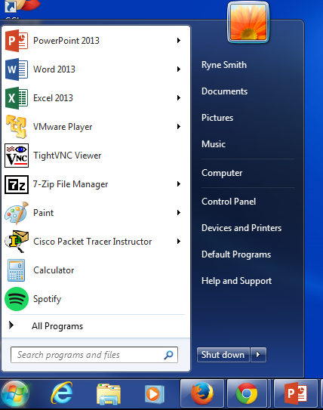
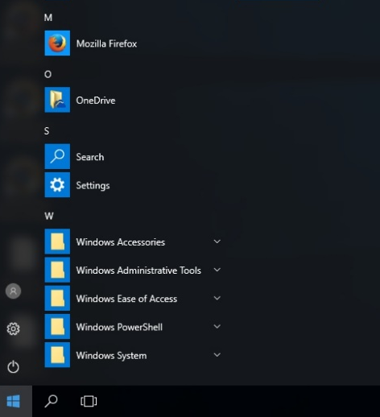
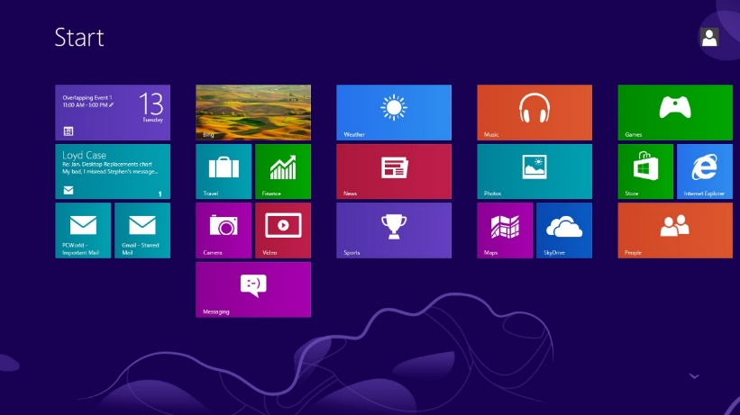
Microsoft Windows: Start Menu and Start Screen
All Windows OSes until Windows 8 included a Start button in the task bar
Clicking the Start button brings up the Start Menu
From the Start Menu, users can search their system, open files and programs, and access system tools
Windows 8 did not have a Start button and replaced the Start Menu with the Start Screen
Windows 8.1 brought the Start button back to take users to the Start Screen
Windows 7
Windows 10
Source: http://windows.microsoft.com/en-us/windows/using-menus-buttons-bars-boxes#1TC=windows-7

Slide 12
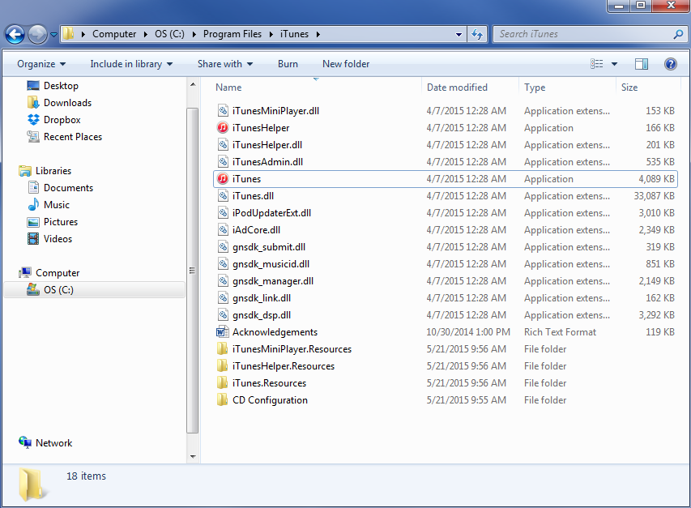
Microsoft Windows: Directory
Files and folders can be accessed through Windows Explorer
A file path is where a file is located on a system
Example file path:
C:\Program Files\iTunes\iTunes.exe
C: - Drive
\Program Files – Folder
\iTunes - Folder
\iTunes.exe - File
Source: http://windows.microsoft.com/en-us/windows/working-with-windows#1TC=windows-7

Slide 13
Microsoft Windows: File Extensions
A group of letters occurring after a period in a file name, indicating the format of the file
Common file extensions in Windows:
.bat – executable batch files
.bmp – Bitmap graphics files
.doc – Word documents (pre-Office 2007)
.docx – Word documents (Office 2007 and later)
.exe – executable files/programs
.ppt – PowerPoint files (pre-Office 2007)
.pptx – PowerPoint files (Office 2007 and later)
.wav – Microsoft audio file
.wmv – Windows Media Video
.xls – Excel spreadsheet (pre-Office 2007)
.xlsx – Excel spreadsheet (Office 2007 and later)

